Slide 1
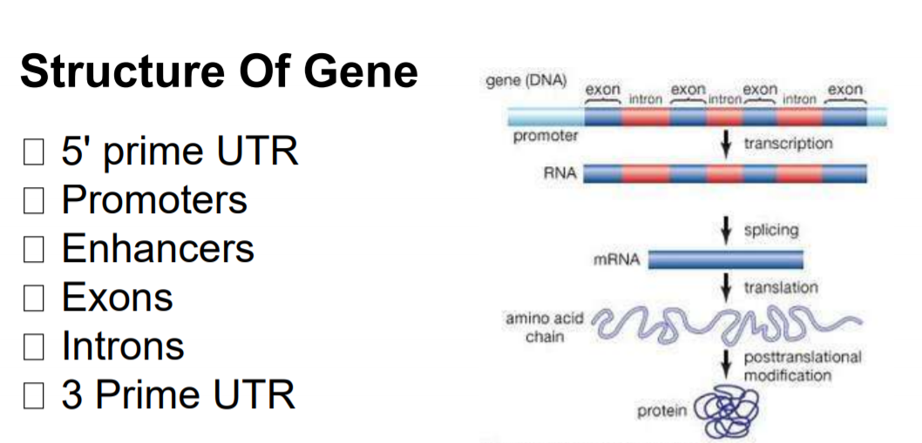
Untranslated region (UTR) of mRNA

Slide 2
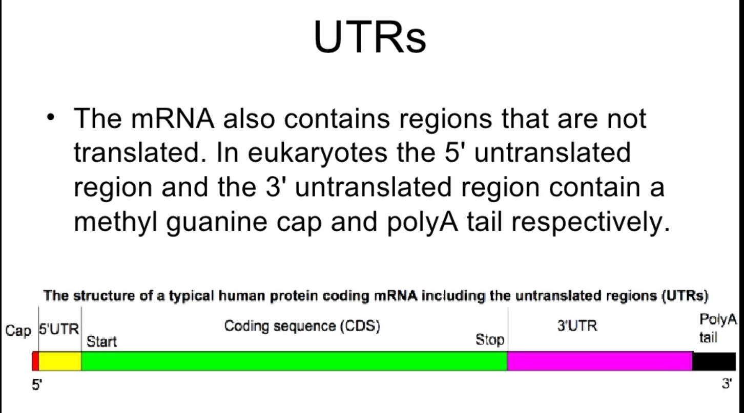
What is Untranslated region (UTR)?

Slide 3
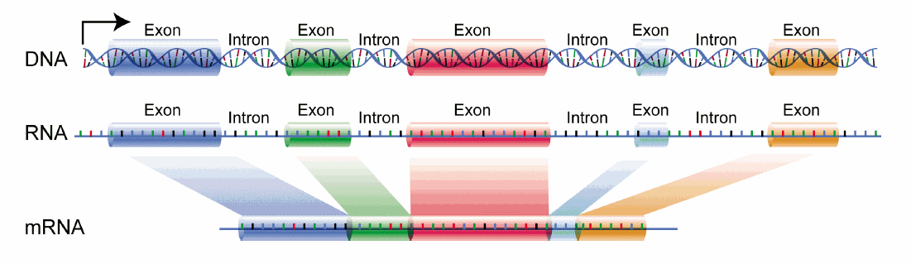
What is mRNA? And UTR vs Intron

Slide 4
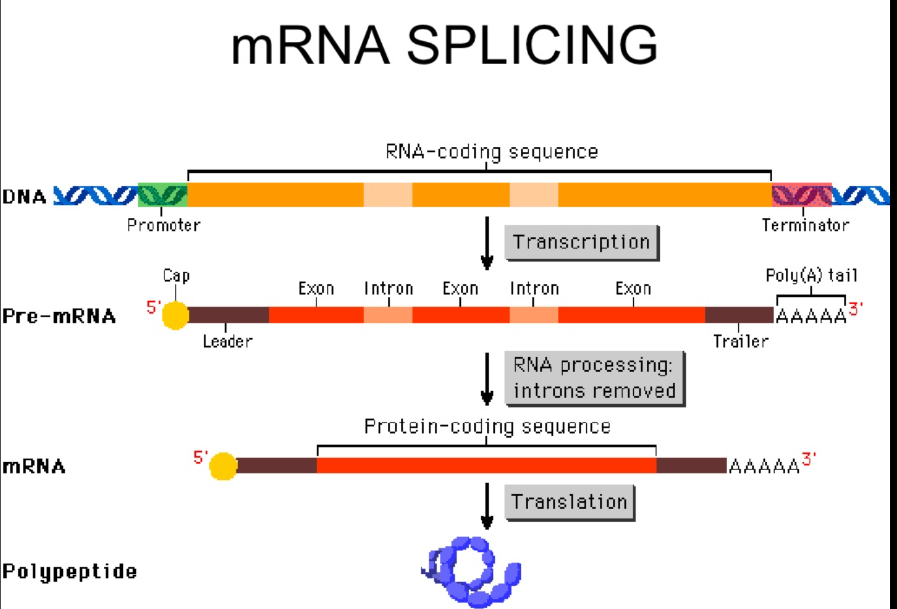
Summary

